Slide 1
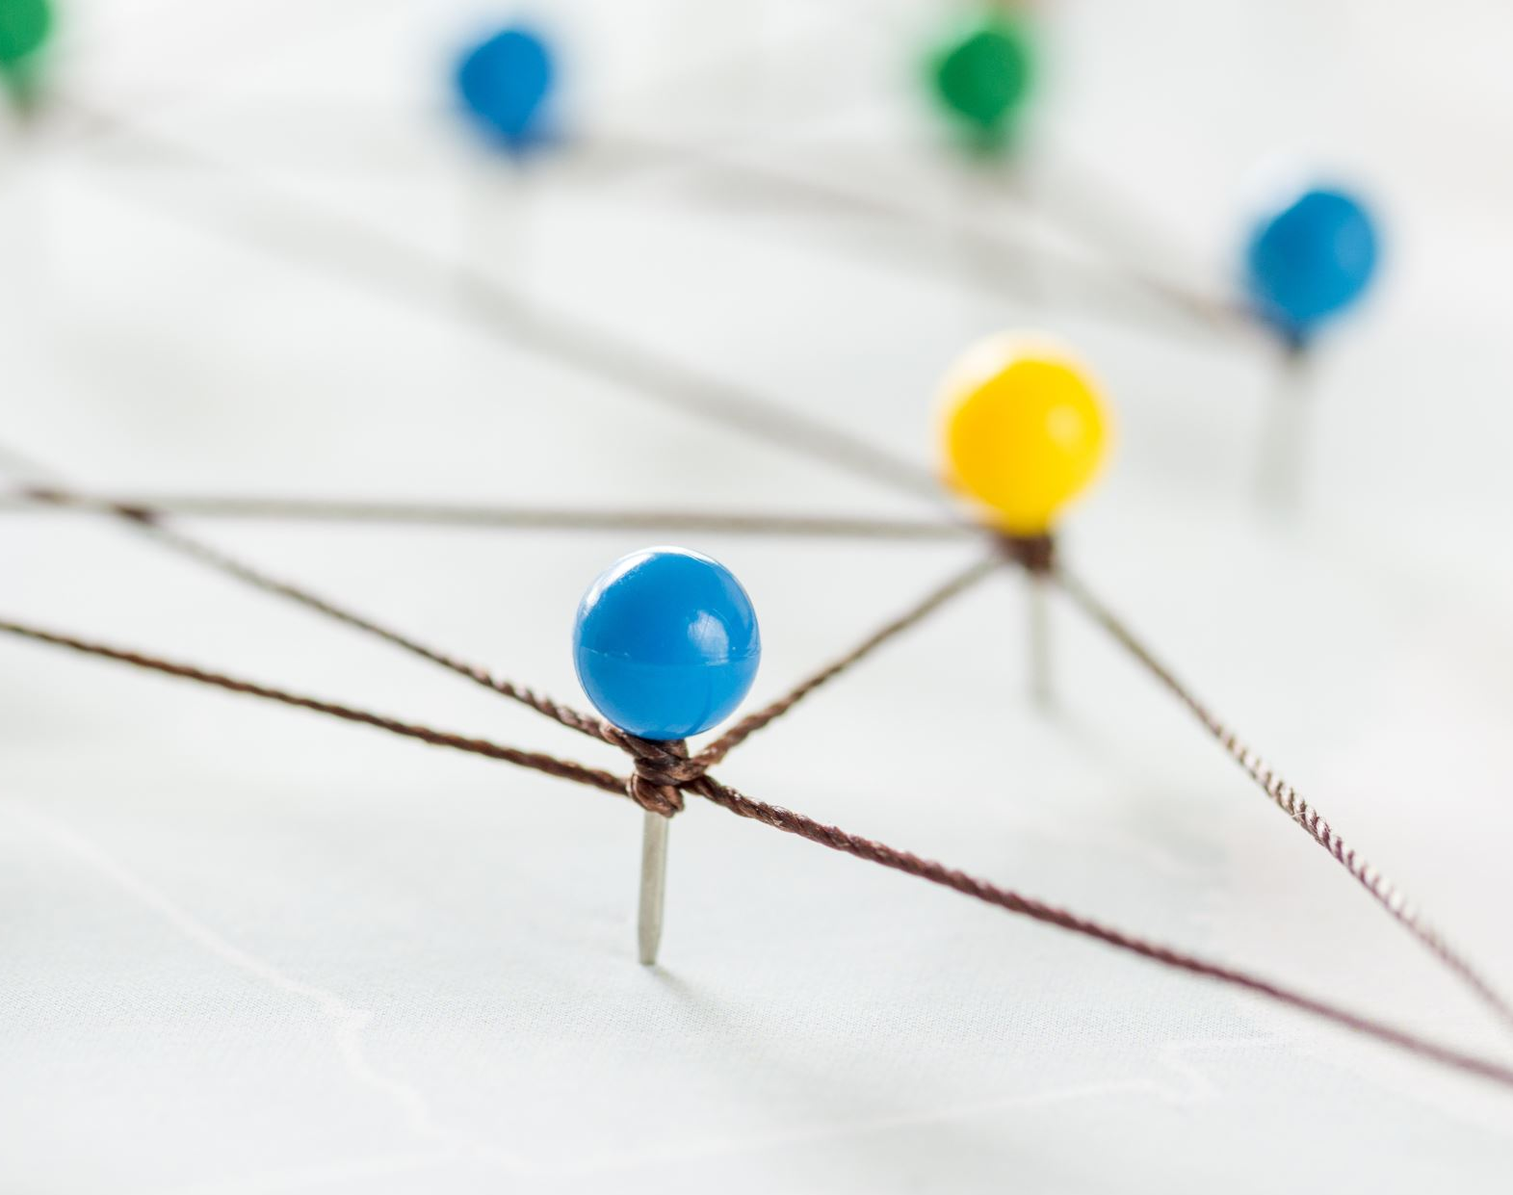
Autoencoders
https://www.edureka.co/blog/autoencoders-tutorial/
https://www.edureka.co/ai-deep-learning-with-tensorflow
https://www.jeremyjordan.me/variational-autoencoders/
https://blog.keras.io/building-autoencoders-in-keras.html
Understanding Latent Space in Machine Learning | by Ekin Tiu | Towards Data Science
Variational Autoencoders (VAEs) for Dummies - Step By Step Tutorial | Towards Data Science

Slide 2
Autoencoders
Artificial Intelligence encircles a wide range of technologies and techniques that enable computer systems to solve problems like Data Compression which is used in computer vision, computer networks, computer architecture, and many other fields.
Autoencoders are unsupervised neural networks that use machine learning to do this compression for us.
This Autoencoders Tutorial will provide you with a complete insight into autoencoders in the following sequence:
What are Autoencoders?
The need for Autoencoders
Applications of Autoencoders
Architecture of Autoencoders
Properties & Hyperparameters
Types of Autoencoders

Slide 3
What are Autoencoders?
Autoencoders are tagged under self-supervised learning.
Some say it's unsupervised as they are independent of the labeled responses when coming to classification.
They are used by neural networks to perform representation learning.
In the image below, the autoencoders contain a bottleneck network that performs compressed knowledge representation for the input.
To leverage the autoencoders performing, you need to make sure that they carefully recreate observation and also learn generalized encoding and decoding methods on the training data.
In autoencoders, middle layers/hidden core layers are of more value than the output layer.

Slide 4
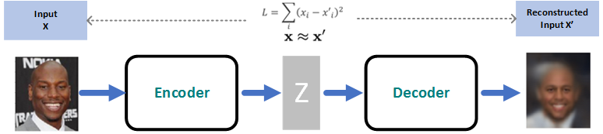
Example

Slide 5
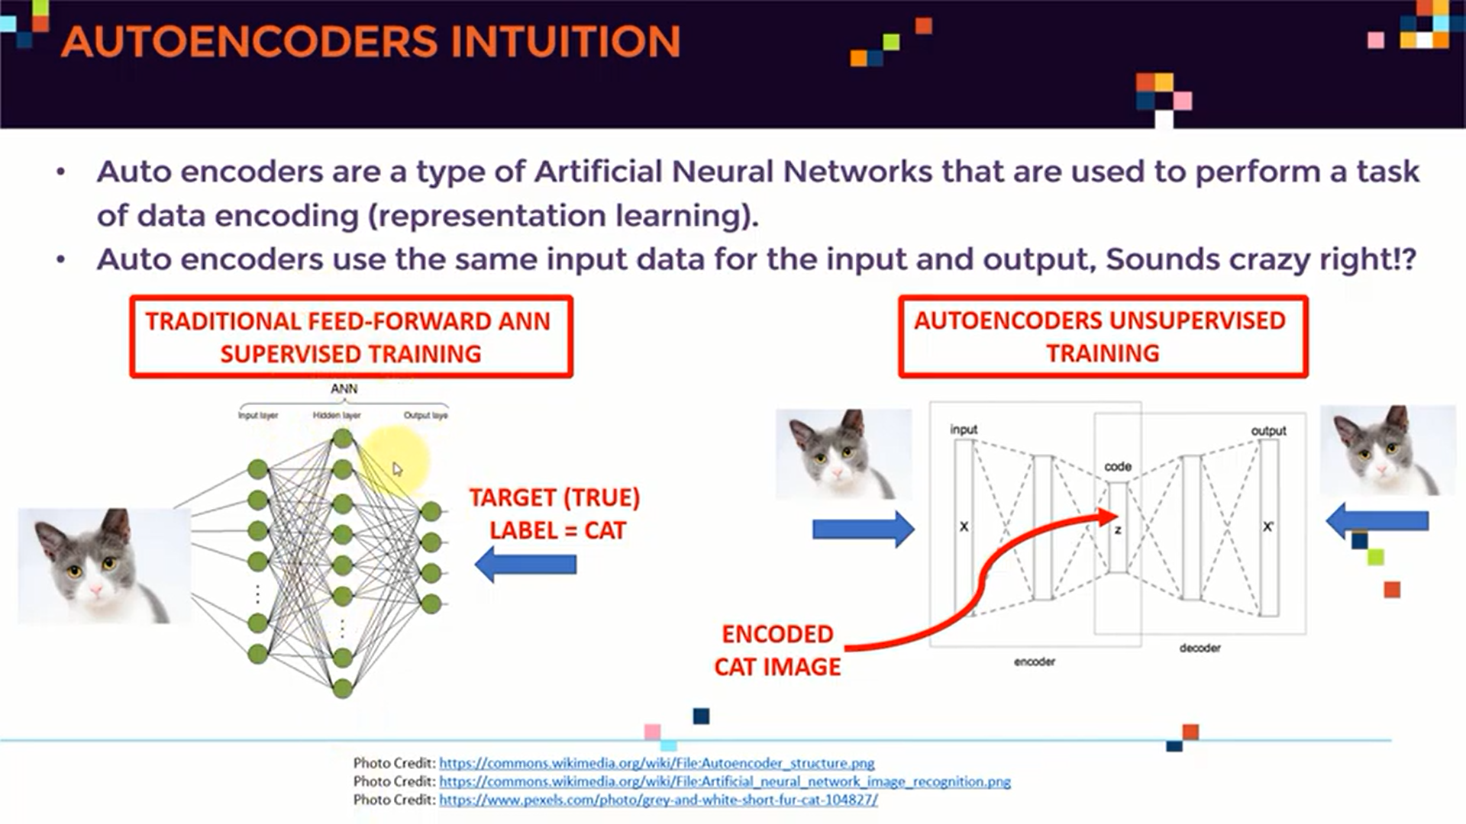

Slide 6
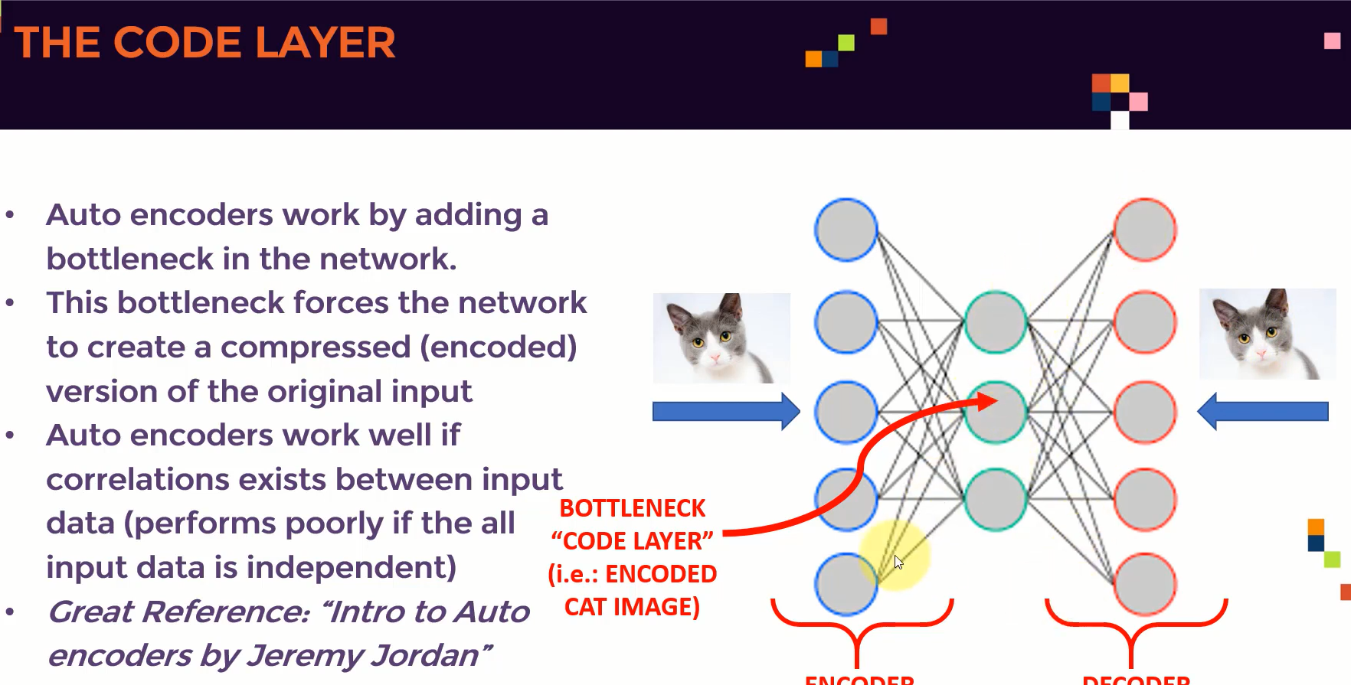

Slide 7
What is an autoencoder?
An autoencoder is a type of artificial neural network used to learn data encodings in an unsupervised manner
.The aim of an autoencoder is to learn a lower-dimensional representation (encoding) for higher-dimensional data, typically for dimensionality reduction, by training the network to capture the most important parts of the input image.
It is an unsupervised ML algorithm similar to PCA.
It minimizes the same objective function as PCA
It is a neural network
The neural network target output is the input

Slide 8
Autoencoders
If the number of neurons in the middle layer is less than the number of neurons in the input layer, the network extracts the more effective information.
The middle layer will not have any other option but to learn the most important image patterns, ignoring the noises.
If you have more neurons in the middle layer, the neural network will have a higher capacity to learn the pattern, making the network lazy.
It will copy and paste the input values to the output values, learn noises, and not extract any feature
Hence, the bottleneck model is essential.

Slide 9
How does PCA(principal component analysis) work…?
PCA is a dimensionality reduction that is often used to reduce the dimension of the variables of a larger dataset that is compressed to the smaller one which contains most of the information to build an efficient model.
In a real-time scenario when you are working reducing the number of variables in the dataset you need compromise on model accuracy but using PCA will give good accuracy.
The idea of PCA is to reduce the variables in the dataset and preserve data as much as possible.

Slide 10
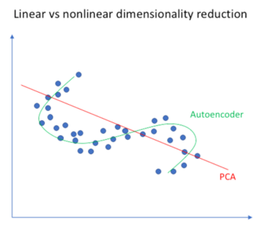
Autoencoders
Autoencoders are preferred over PCA because:
An autoencoder can learn non-linear transformations with a non-linear activation function and multiple layers.
It doesn’t have to learn dense layers.
It can use convolutional layers to learn which is better for video, image and series data.
It is more efficient to learn several layers with an autoencoder rather than learn one huge transformation with PCA.
An autoencoder provides a representation of each layer as the output.
It can make use of pre-trained layers from another model to apply transfer learning to enhance the encoder/decoder.

Slide 11
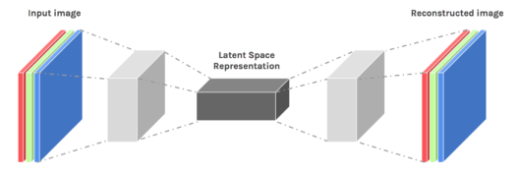
What are Autoencoders?

Slide 12
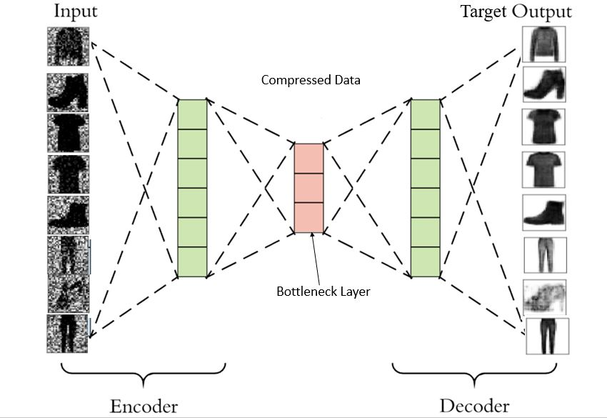

Slide 13
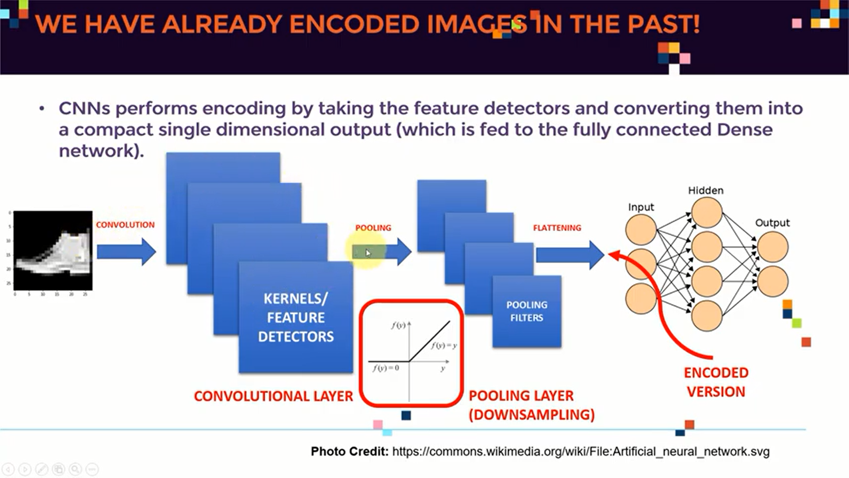

Slide 14
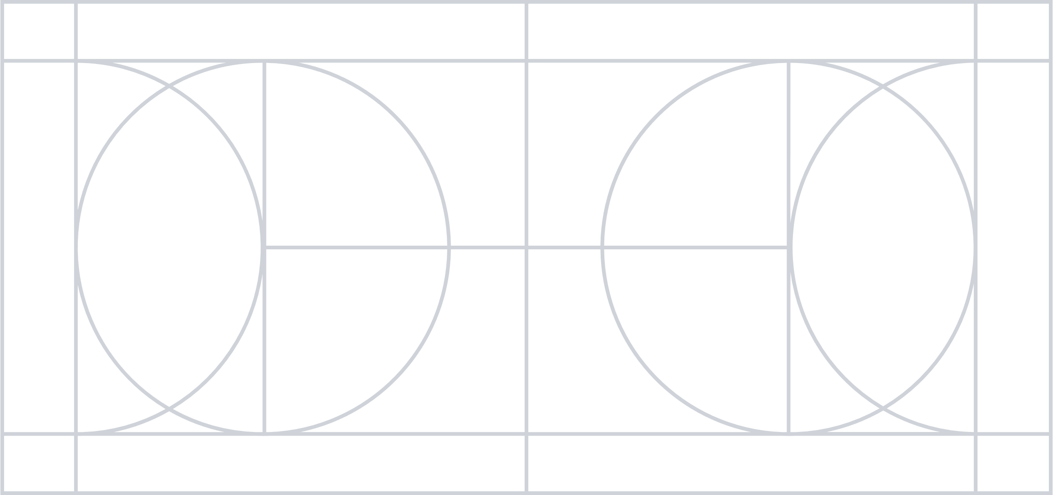
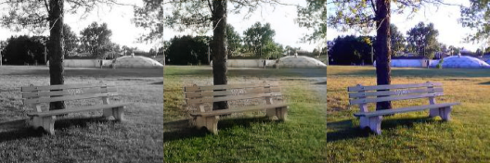
Applications of Autoencoders
Image Coloring
Autoencoders are used for converting any black and white picture into a colored image.
Depending on what is in the picture, it is possible to tell what the color should be.

Slide 15
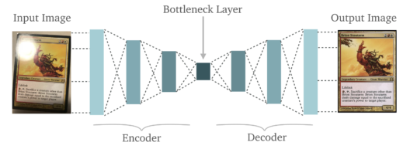
Applications of Autoencoders
Feature variation
It extracts only the required features of an image and generates the output by removing any noise or unnecessary interruption.

Slide 16
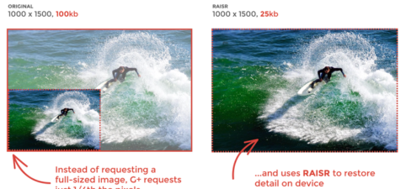
Applications of Autoencoders
Dimensionality Reduction
The reconstructed image is the same as our input but with reduced dimensions. It helps in providing the similar image with a reduced pixel value.

Slide 17
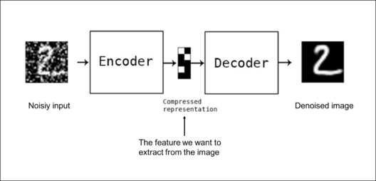
Applications of Autoencoders
Denoising Image
The input seen by the autoencoder is not the raw input but a stochastically corrupted version.
A denoising autoencoder is thus trained to reconstruct the original input from the noisy version.

Slide 18
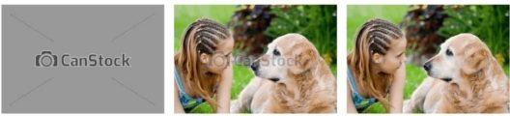
Applications of Autoencoders
Watermark Removal
It is also used for removing watermarks from images or to remove any object while filming a video or a movie.

Slide 19
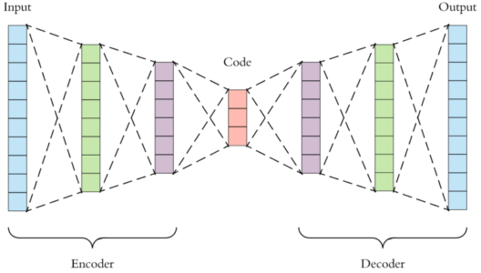
Architecture of Autoencoders
An Autoencoder consist of three layers:
Encoder
Code
Decoder

Slide 20
Architecture of Autoencoders
Encoder: This part of the network compresses the input into a latent space representation.
The encoder layer encodes the input image as a compressed representation in a reduced dimension.
The compressed image is the distorted version of the original image.
Code: This part of the network represents the compressed input which is fed to the decoder.
Decoder: This layer decodes the encoded image back to the original dimension. The decoded image is a lossy reconstruction of the original image and it is reconstructed from the latent space representation.

Slide 21
The relationship between the Encoder, Bottleneck, and Decoder
Encoder
The encoder is a set of convolutional blocks followed by pooling modules that compress the input to the model into a compact section called the bottleneck.
The bottleneck is followed by the decoder that consists of a series of upsampling modules to bring the compressed feature back into the form of an image. In case of simple autoencoders, the output is expected to be the same as the input with reduced noise.
However, for variational autoencoders it is a completely new image, formed with information the model has been provided as input.

Slide 22
The relationship between the Encoder, Bottleneck, and Decoder
Bottleneck
The most important part of the neural network, and ironically the smallest one, is the bottleneck. The bottleneck exists to restrict the flow of information to the decoder from the encoder, thus,allowing only the most vital information to pass through.
Since the bottleneck is designed in such a way that the maximum information possessed by an image is captured in it, we can say that the bottleneck helps us form a knowledge-representation of the input.
Thus, the encoder-decoder structure helps us extract the most from an image in the form of data and establish useful correlations between various inputs within the network.
A bottleneck as a compressed representation of the input further prevents the neural network from memorising the input and overfitting on the data.
As a rule of thumb, remember this: The smaller the bottleneck, the lower the risk of overfitting.
However—
Very small bottlenecks would restrict the amount of information storable, which increases the chances of important information slipping out through the pooling layers of the encoder.

Slide 23
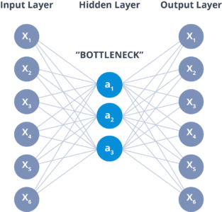
Bottleneck Layer
The layer between the encoder and decoder, ie. the code is also known as Bottleneck.
This is a well-designed approach to decide which aspects of observed data are relevant information and what aspects can be discarded.
It does this by balancing two criteria :
Compactness of representation, measured as the compressibility.
It retains some behaviorally relevant variables from the input.

Slide 24
The relationship between the Encoder, Bottleneck, and Decoder
Decoder
Finally, the decoder is a set of upsampling and convolutional blocks that reconstructs the bottleneck's output.
Since the input to the decoder is a compressed knowledge representation, the decoder serves as a “decompressor” and builds back the image from its latent attributes.

Slide 25
Properties of Autoencoders:
Data-specific: Autoencoders are only able to compress data similar to what they have been trained on.
Lossy: The decompressed outputs will be degraded compared to the original inputs.
Learned automatically from examples: It is easy to train specialized instances of the algorithm that will perform well on a specific type of input.

Slide 26
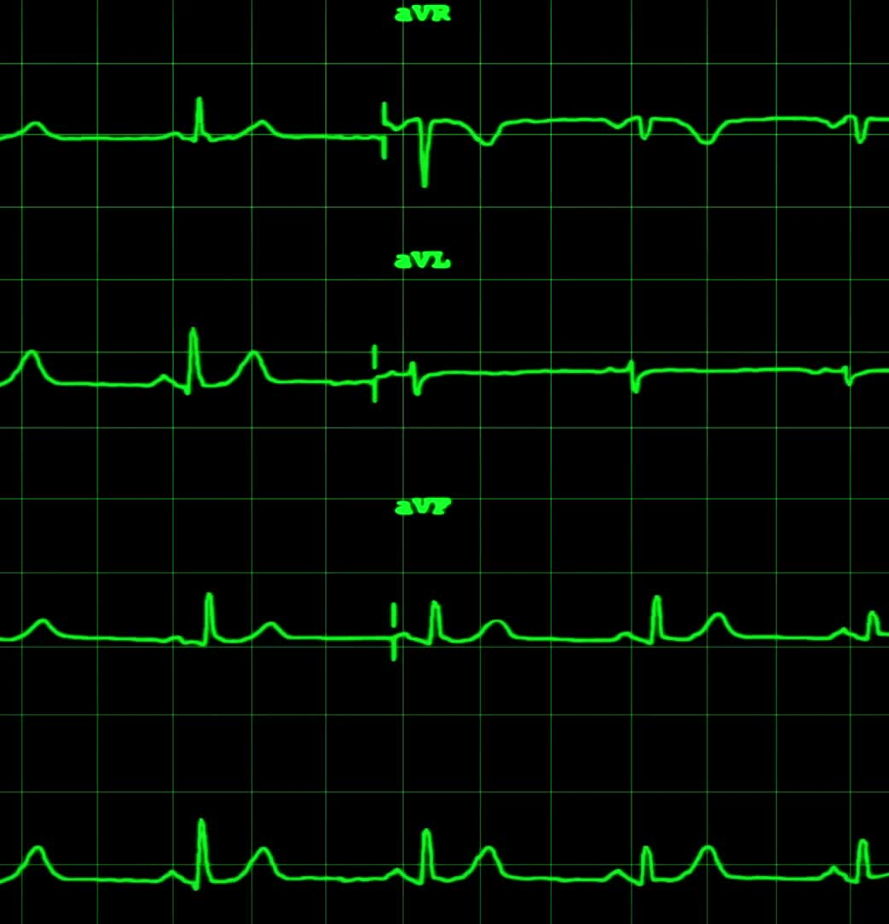
Hyperparameters of Autoencoders:
There are 4 hyperparameters that we need to set before training an autoencoder:
Code size: It represents the number of nodes in the middle layer. Smaller size results in more compression.
Number of layers: The autoencoder can consist of as many layers as we want.
Number of nodes per layer: The number of nodes per layer decreases with each subsequent layer of the encoder, and increases back in the decoder. The decoder is symmetric to the encoder in terms of the layer structure.
Loss function: We either use mean squared error or binary cross-entropy. If the input values are in the range [0, 1] then we typically use cross-entropy, otherwise, we use the mean squared error.

Slide 27
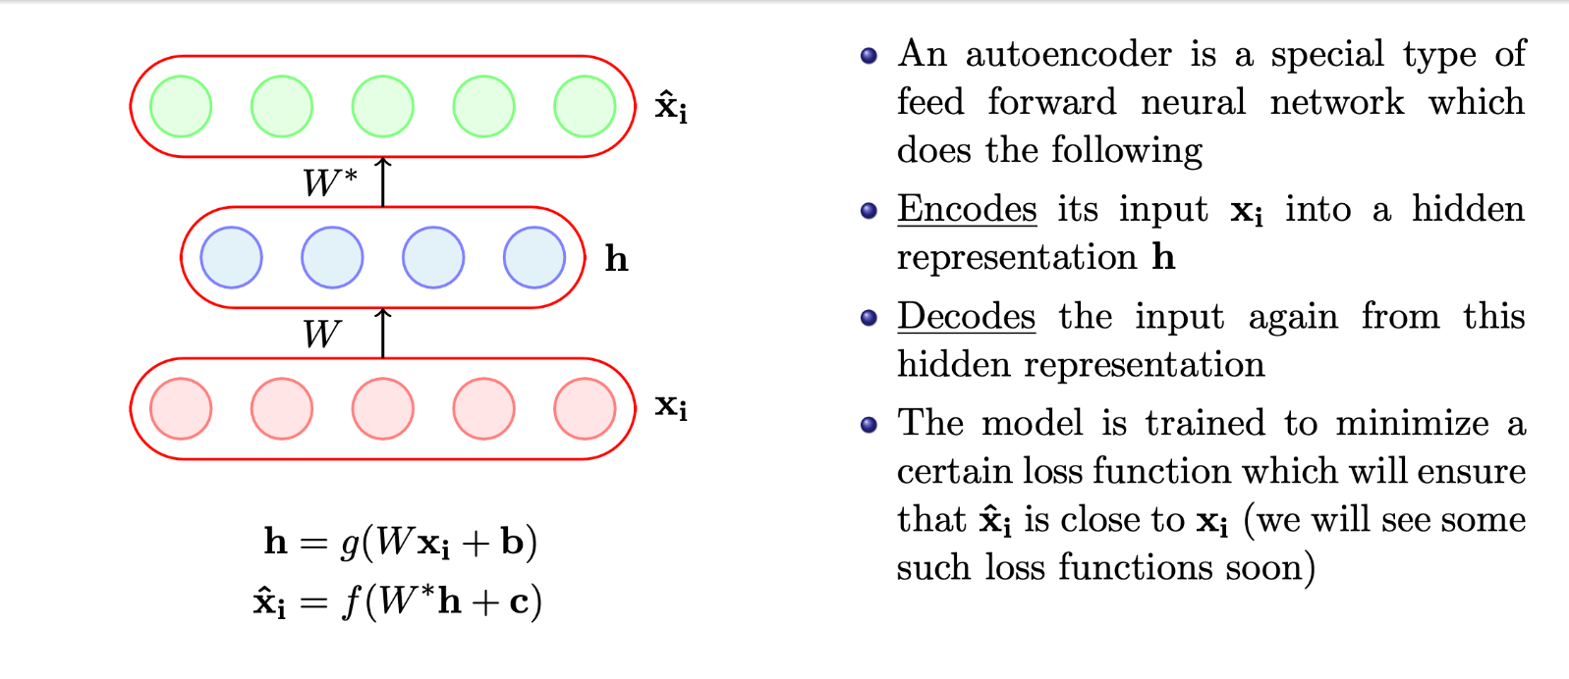
Encoder -Decoder Model

Slide 28
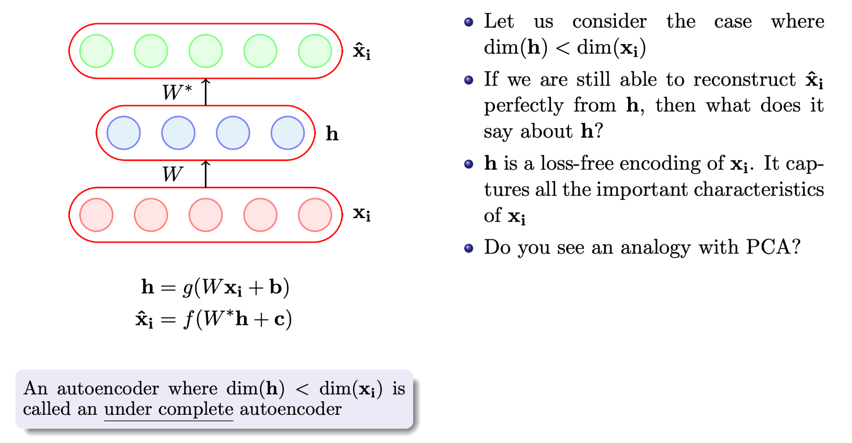
Under Complete Autoencoder

Slide 29
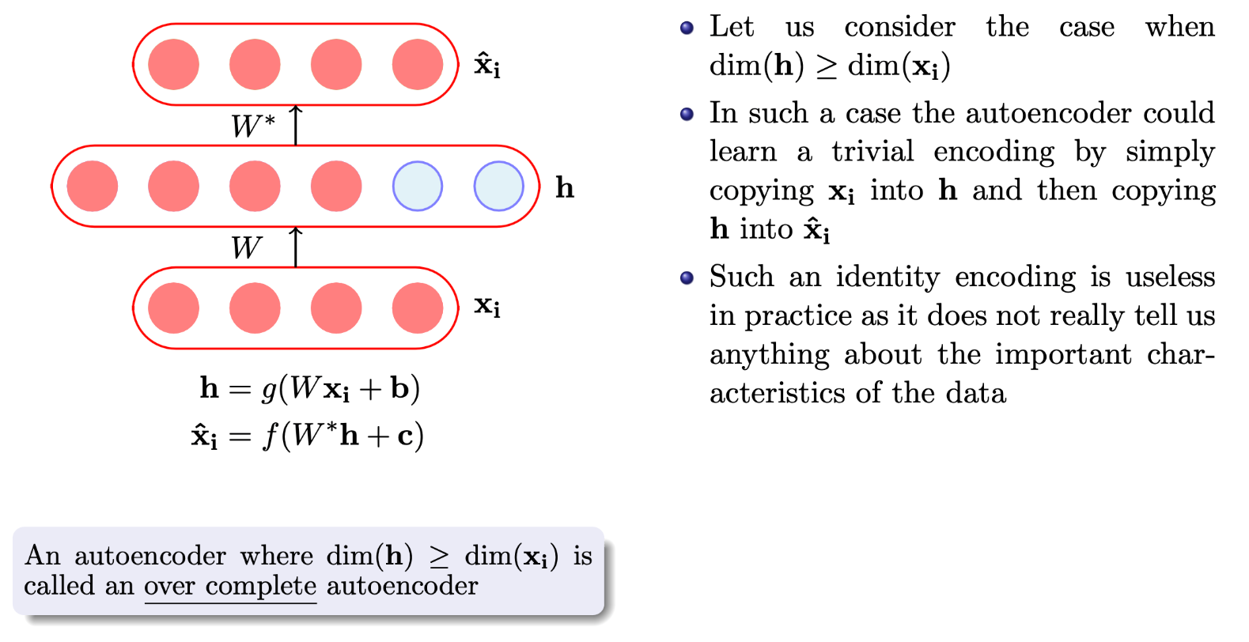
Over Complete Autoencoder

Slide 30
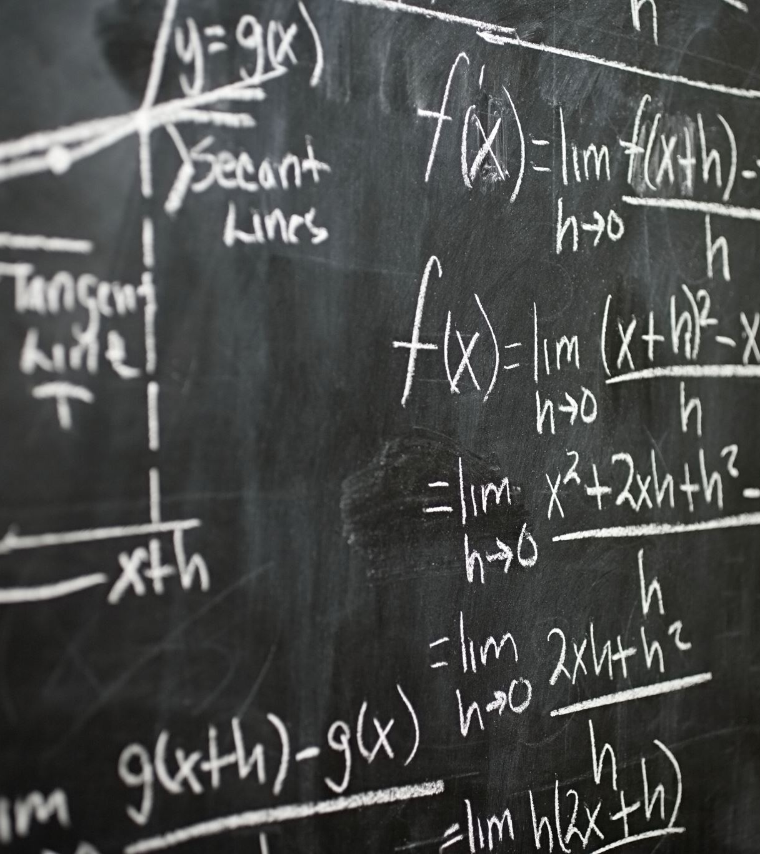
What is Latent Space?
If I have to describe latent space in one sentence, it simply means a representation of compressed data.
The concept of “latent space” is important because it’s utility is at the core of ‘deep learning’ — learning the features of data and simplifying data representations for the purpose of finding patterns.

Slide 31
Why do we compress data in ML?
Data compression is defined as the process of encoding information using fewer bits than the original representation.
This is like taking a 19D data point (need 19 values to define unique point) and squishing all that information into a 9D data point.
More often than not, data is compressed in machine learning to learn important information about data points. Let us discuss an example.
Say we would like to train a model to classify an image using a fully convolutional neural network (FCN). (i.e. output digit number given image of digit). As the model ‘learns’, it is simply learning features at each layer (edges, angles, etc.) and attributing a combination of features to a specific output.
But each time the model learns through a data point, the dimensionality of the image is first reduced before it is ultimately increased. (see Encoder and Bottleneck below). When the dimensionality is reduced, we consider this a form of lossy compression.
Because the model is required to then reconstruct the compressed data (see Decoder), it must learn to store all relevant information and disregard the noise. This is the value of compression- it allows us to get rid of any extraneous information, and only focus on the most important features.
This ‘compressed state’ is the Latent Space Representation of our data.

Slide 32
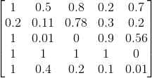
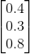
Latent Space-Compression
You may be wondering why we call it a latent space. After all, compressed data, at first glance, may not evoke any sort of “space.”
But here’s the parallel.
In this rather simplistic example, let’s say our original dataset are images with dimensions 5 x 5 x 1. We will set our latent space dimensions to be 3 x 1, meaning our compressed data point is a vector with 3-dimensions.
Example compressed 3x1 data in ‘latent space’
Example 5x5x1 data

Slide 33
Representation Learning
The latent space representation of our data contains all the important information needed to represent our original data point.
This representation must then represent the features of the original data.
In other words, the model learns the data features and simplifies its representation to make it easier to analyze.
This is at the core of a concept called Representation Learning, defined as a set of techniques that allow a system to discover the representations needed for feature detection or classification from raw data.
In this use case, our latent space representations are used to transform more complex forms of raw data (i.e. images, video), into simpler representations which are ‘more convenient to process’ and analyze.

Slide 34
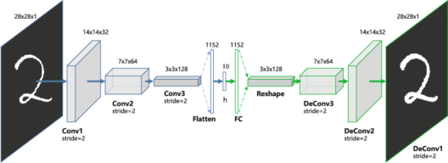
Types of Autoencoders-Convolutional Autoencoders
Autoencoders in their traditional formulation does not take into account the fact that a signal can be seen as a sum of other signals.
Convolutional Autoencoders use the convolution operator to exploit this observation.
They learn to encode the input in a set of simple signals and then try to reconstruct the input from them, modify the geometry or the reflectance of the image.
Use cases of CAE:
Image Reconstruction
Image Colorization
latent space clustering
generating higher resolution images
https://towardsdatascience.com/convolutional-autoencoders-for-image-noise-reduction-32fce9fc1763

Slide 36
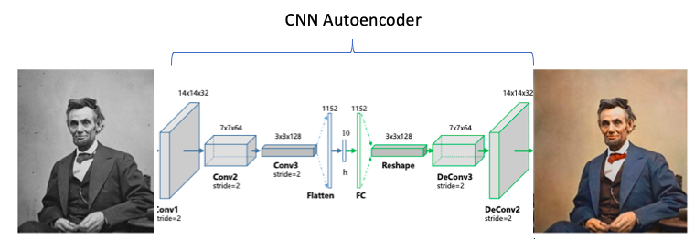

Slide 37
Autoencoders are a specific type of feedforward neural network where the input is the same as the output. They compress the input into a lower-dimensional code and then reconstruct the output from this representation. The code is a compact “summary” or “compression” of the input, also called the latent-space representation.
An autoencoder consists of 3 components: encoder, code and decoder. The encoder compresses the input and produces the code, the decoder then reconstructs the input only using this code.

Slide 38
Autoencoders are mainly a dimensionality reduction (or compression) algorithm with a couple of important properties:
Data-specific: Autoencoders are only able to meaningfully compress data similar to what they have been trained on. Since they learn features specific for the given training data, they are different than a standard data compression algorithm like gzip. So we can’t expect an autoencoder trained on handwritten digits to compress landscape photos.
Lossy: The output of the autoencoder will not be exactly the same as the input, it will be a close but degraded representation. If you want lossless compression they are not the way to go.
Unsupervised: To train an autoencoder we don’t need to do anything fancy, just throw the raw input data at it. Autoencoders are considered an unsupervised learning technique since they don’t need explicit labels to train on. But to be more precise they are self-supervised because they generate their own labels from the training data.

Slide 39
Denoising Autoencoders
Keeping the code layer small forced our autoencoder to learn an intelligent representation of the data. There is another way to force the autoencoder to learn useful features, which is adding random noise to its inputs and making it recover the original noise-free data. This way the autoencoder can’t simply copy the input to its output because the input also contains random noise. We are asking it to subtract the noise and produce the underlying meaningful data. This is called a denoising autoencoder.

Slide 40
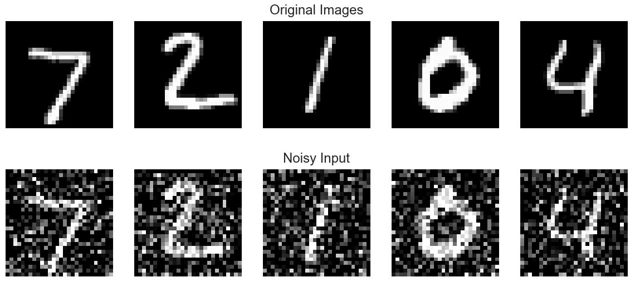

Slide 41
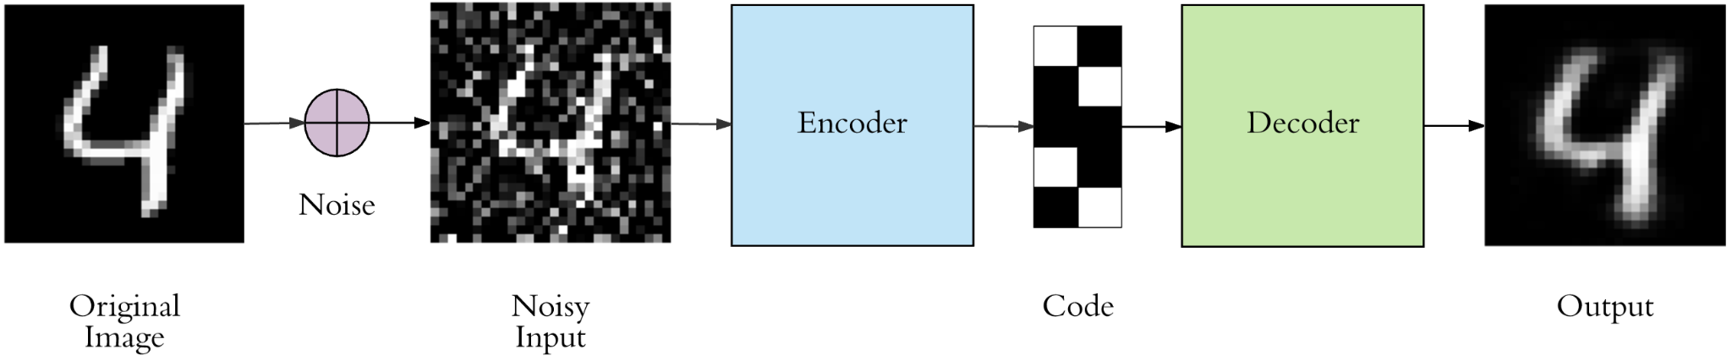
The top row contains the original images. We add random Gaussian noise to them and the noisy data becomes the input to the autoencoder. The autoencoder doesn’t see the original image at all. But then we expect the autoencoder to regenerate the noise-free original image.

Slide 42
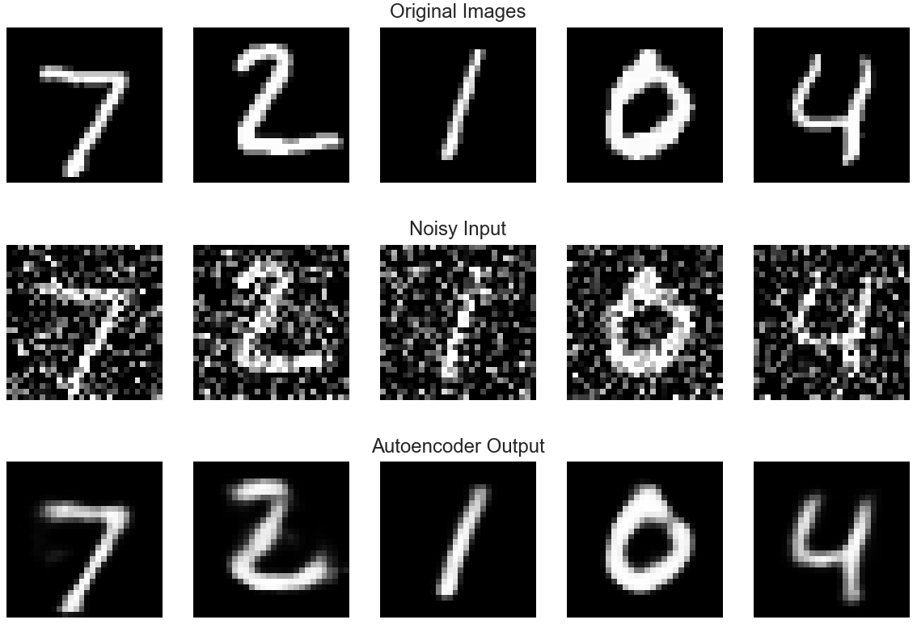

Slide 43
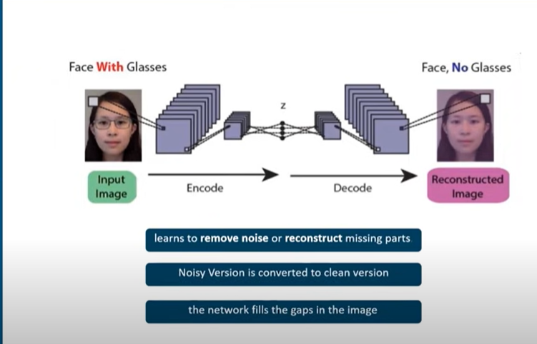
Image Reconstruction

Slide 44
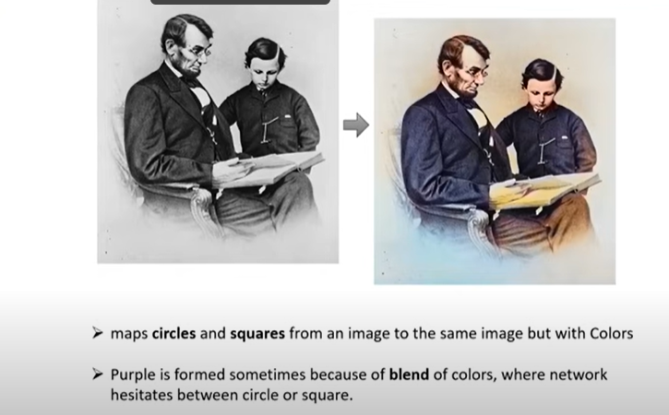
Image Colorization

Slide 45
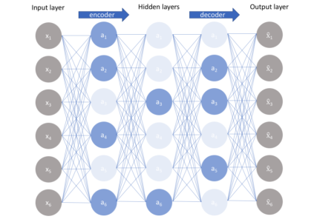
Sparse Autoencoders
Sparse autoencoders offer us an alternative method for introducing an information bottleneck without requiring a reduction in the number of nodes at our hidden layers.
Instead, we’ll construct our loss function such that we penalize activations within a layer.
https://towardsdatascience.com/sparse-autoencoder-neural-networks-how-to-utilise-sparsity-for-robust-information-encoding-6aa9ff542bc9

Slide 46
Sparse Autoencoder
A sparse autoencoder is simply an autoencoder whose training criterion involves a sparsity penalty.
In most cases, we would construct our loss function by penalizing activations of hidden layers so that only a few nodes are encouraged to activate when a single sample is fed into the network.
The intuition behind this method is that, for example, if a man claims to be an expert in mathematics, computer science, psychology, and classical music, he might be just learning some quite shallow knowledge in these subjects.
However, if he only claims to be devoted to mathematics, we would like to anticipate some useful insights from him.
And it’s the same for autoencoders we’re training — fewer nodes activating while still keeping its performance would guarantee that the autoencoder is actually learning latent representations instead of redundant information in our input data.

Slide 47
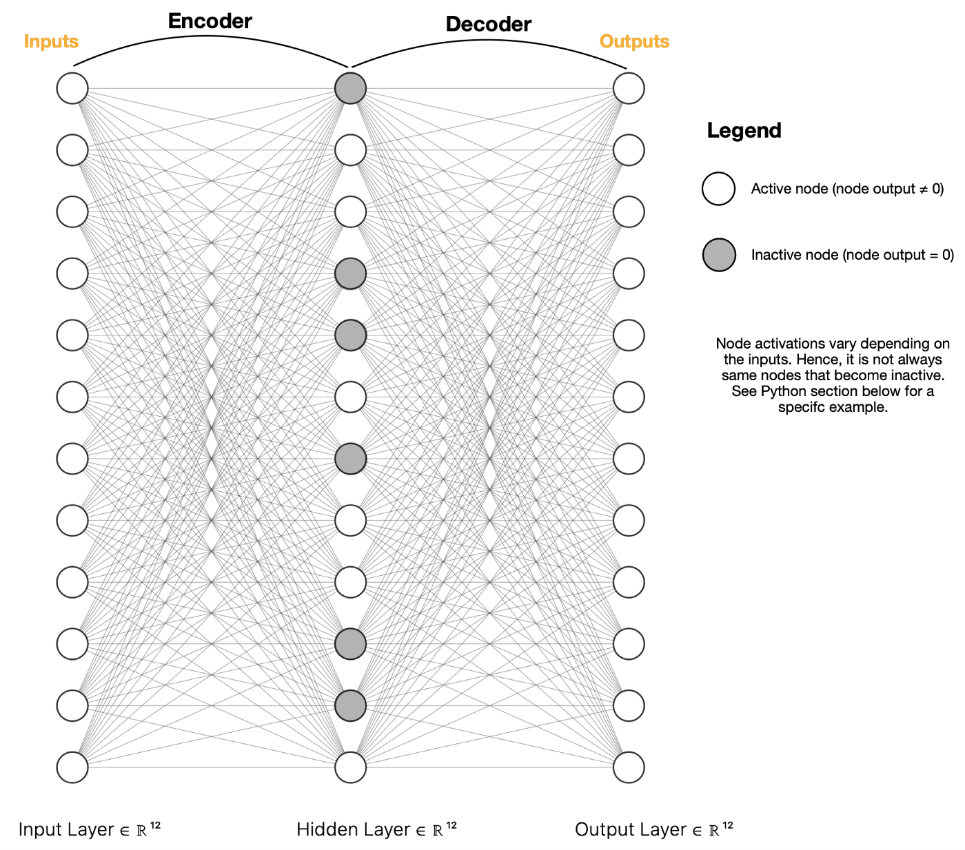
the goal of an SAE is the same as an Undercomplete AE, but it achieves it differently. Instead of (or in addition to) relying on fewer neurons, SAE uses regularisation to enforce sparsity.By sparsity, we mean that fewer neurons can be activated at the same time, creating an information bottleneck similar to that of Unercomplete AE. See the below illustration.

Slide 48
Variational Autoencoder
A variational autoencoder (VAE) provides a probabilistic manner for describing an observation in latent space.
Thus, rather than building an encoder which outputs a single value to describe each latent state attribute, we'll formulate our encoder to describe a probability distribution for each latent attribute.
Intuition
To provide an example, let's suppose we've trained an autoencoder model on a large dataset of faces with a encoding dimension of 6. An ideal autoencoder will learn descriptive attributes of faces such as skin color, whether or not the person is wearing glasses, etc. in an attempt to describe an observation in some compressed representation.
https://www.jeremyjordan.me/variational-autoencoders/

Slide 49
What is a Variational Autoencoder (VAE)?
Typically, the latent space z produced by the encoder is sparsely populated, meaning that it is difficult to predict the distribution of values in that space.
Values are scattered and space will appear to be well utilized in a 2D representation.
This is a very good property for compression systems.
However, for generating new celebrity images this sparsity is an issue because finding a latent value for which the decoder will know how to produce a valid image is almost impossible.
Furthermore, if space has gaps between clusters, and the decoder receives a variation from there, it will lack the knowledge to generate something useful.

Slide 50
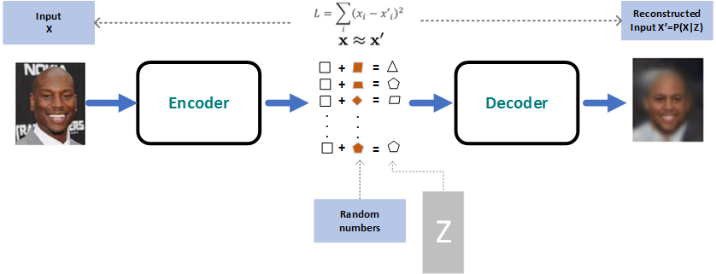
Variational Autoencoder
Variational Autoencoder works by making the latent space more predictable, more continuous, less sparse. By forcing latent variables to become normally distributed, VAEs gain control over the latent space.

Slide 51
Variational Autoencoder-Latent Space
Instead of forwarding the latent values to the decoder directly, VAEs use them to calculate a mean and a standard deviation.
The input to the decoder is then sampled from the corresponding normal distribution.
During training, VAEs force this normal distribution to be as close as possible to the standard normal distribution by including the Kullback–Leibler divergence in the loss function.
VAE will be altering, or exploring variations on the faces, and not just in a random way, but in a desired, specific direction.
Conditional Variational Autoencoders allow modeling the input based on both the latent variable z and additional information such as metadata of the face (smile, glasses, skin color, etc.).

Slide 52
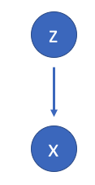
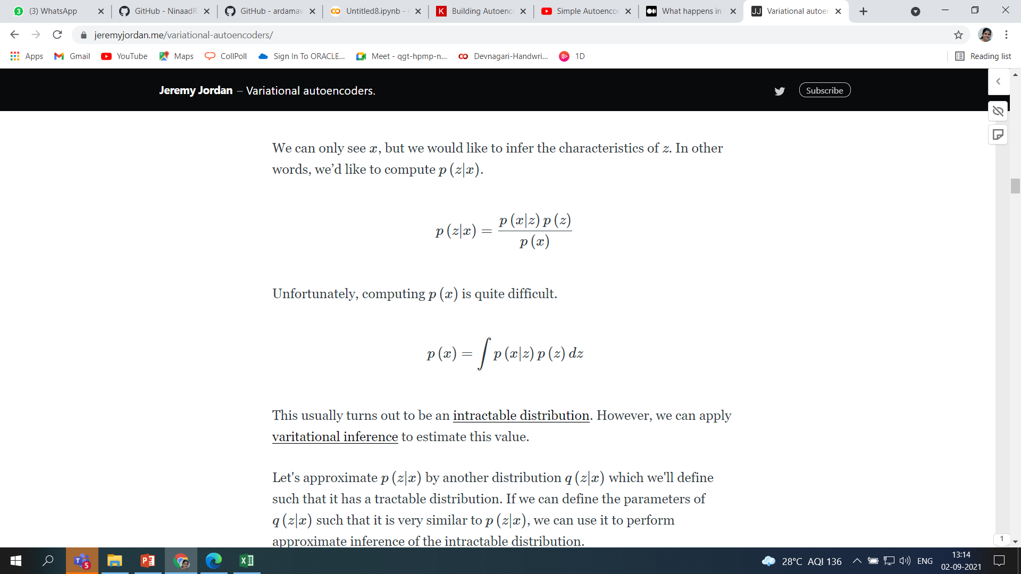
Variational Autoencoder
Statistical motivation
Suppose that there exists some hidden variable z which generates an observation x.
We can only see x, but we would like to infer the characteristics of z. In other words, we’d like to compute p(z|x).
Unfortunately, computing p(x) is quite difficult.

Slide 53
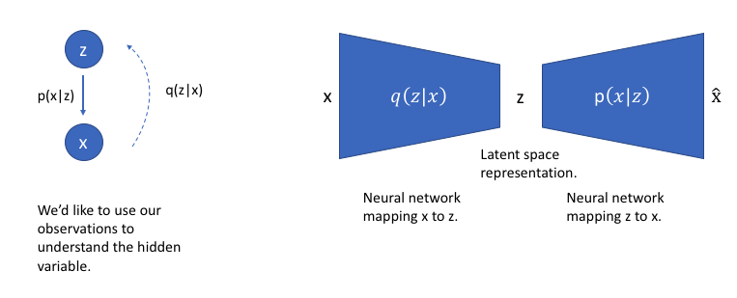
Variational Autoencoder
To revisit our graphical model, we can use q to infer the possible hidden variables (ie. latent state) which was used to generate an observation. We can further construct this model into a neural network architecture where the encoder model learns a mapping from x to z and the decoder model learns a mapping from z back to x.

Slide 54
Variational Autoencoder
Rather than directly outputting values for the latent state as we would in a standard autoencoder, the encoder model of a VAE will output parameters describing a distribution for each dimension in the latent space.
Since we're assuming that our prior follows a normal distribution, we'll output two vectors describing the mean and variance of the latent state distributions.
If we were to build a true multivariate Gaussian model, we'd need to define a covariance matrix describing how each of the dimensions are correlated.
However, we'll make a simplifying assumption that our covariance matrix only has nonzero values on the diagonal, allowing us to describe this information in a simple vector.
Our decoder model will then generate a latent vector by sampling from these defined distributions and proceed to develop a reconstruction of the original input.

Slide 55
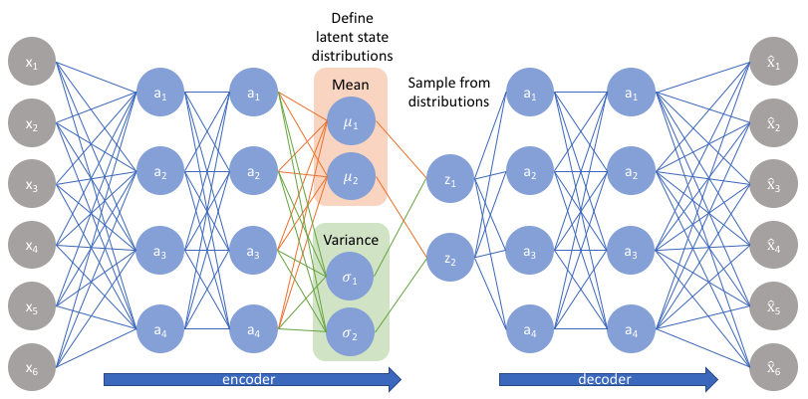
Variational Autoencoder

Slide 56
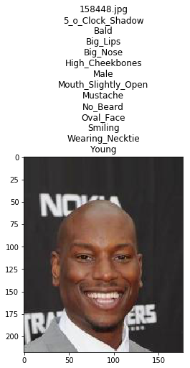
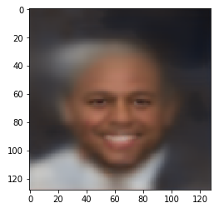
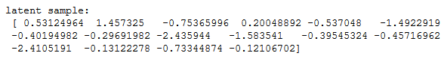
Visualizing Latent Representations
After training, we can now pick an image randomly from our dataset and use the trained encoder to create a latent representation of the image
Using the latent representation, a vector of 16 real numbers, we can visualize how the decoder reconstructed the original image.
Although the reconstructed image is blurry, we can see a strong similarity with the original image: gender, clothes color, hairs, smile, skin color.

Slide 57
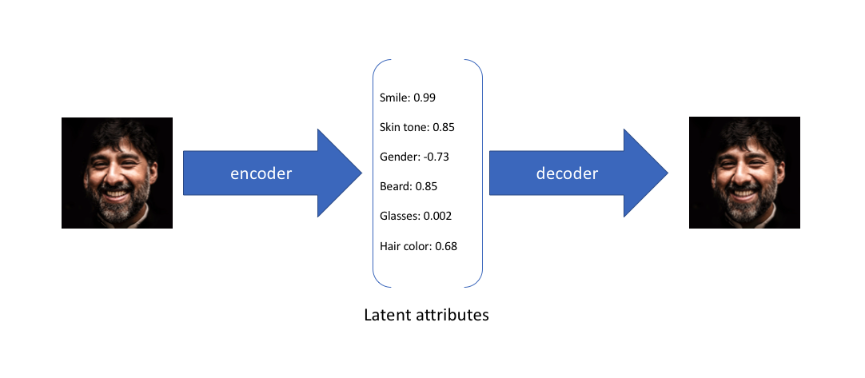
Variational Autoencoder

Slide 58
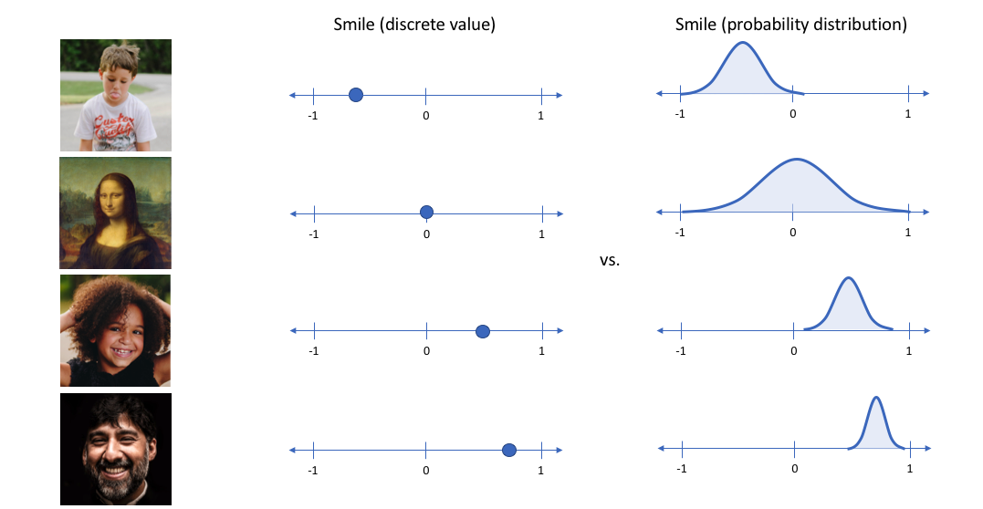
Variational Autoencoder
In the example above, we've described the input image in terms of its latent attributes using a single value to describe each attribute.
However, we may prefer to represent each latent attribute as a range of possible values.
For instance, what single value would you assign for the smile attribute if you feed in a photo of the Mona Lisa?
Using a variational autoencoder, we can describe latent attributes in probabilistic terms.

Slide 59
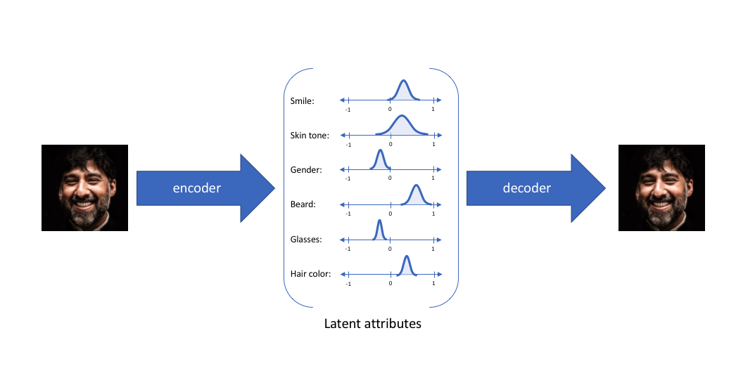
Variational Autoencoder
With this approach, we'll now represent each latent attribute for a given input as a probability distribution.
When decoding from the latent state, we'll randomly sample from each latent state distribution to generate a vector as input for our decoder model.

Slide 60
Variational Autoencoder
Note: For variational autoencoders, the encoder model is sometimes referred to as the recognition model whereas the decoder model is sometimes referred to as the generative model.
By constructing our encoder model to output a range of possible values (a statistical distribution) from which we'll randomly sample to feed into our decoder model, we're essentially enforcing a continuous, smooth latent space representation.
For any sampling of the latent distributions, we're expecting our decoder model to be able to accurately reconstruct the input.
Thus, values which are nearby to one another in latent space should correspond with very similar reconstructions.

Slide 61
The VAE Network
We want the encoder to be a convolutional neural network that takes an image and outputs the parameters of the distribution Q(z|[x, c]) where x is the input image of the face, c is the conditioning variable (attributes of the face) and z is the latent variable.
For this article, we use a simple architecture made of two convolutional layers and a pooling layer.
The decoder is a convolutional neural network built the other way around. It is a generative network that outputs parameters to the likelihood distribution P([x,c]|z).

